Slide 1
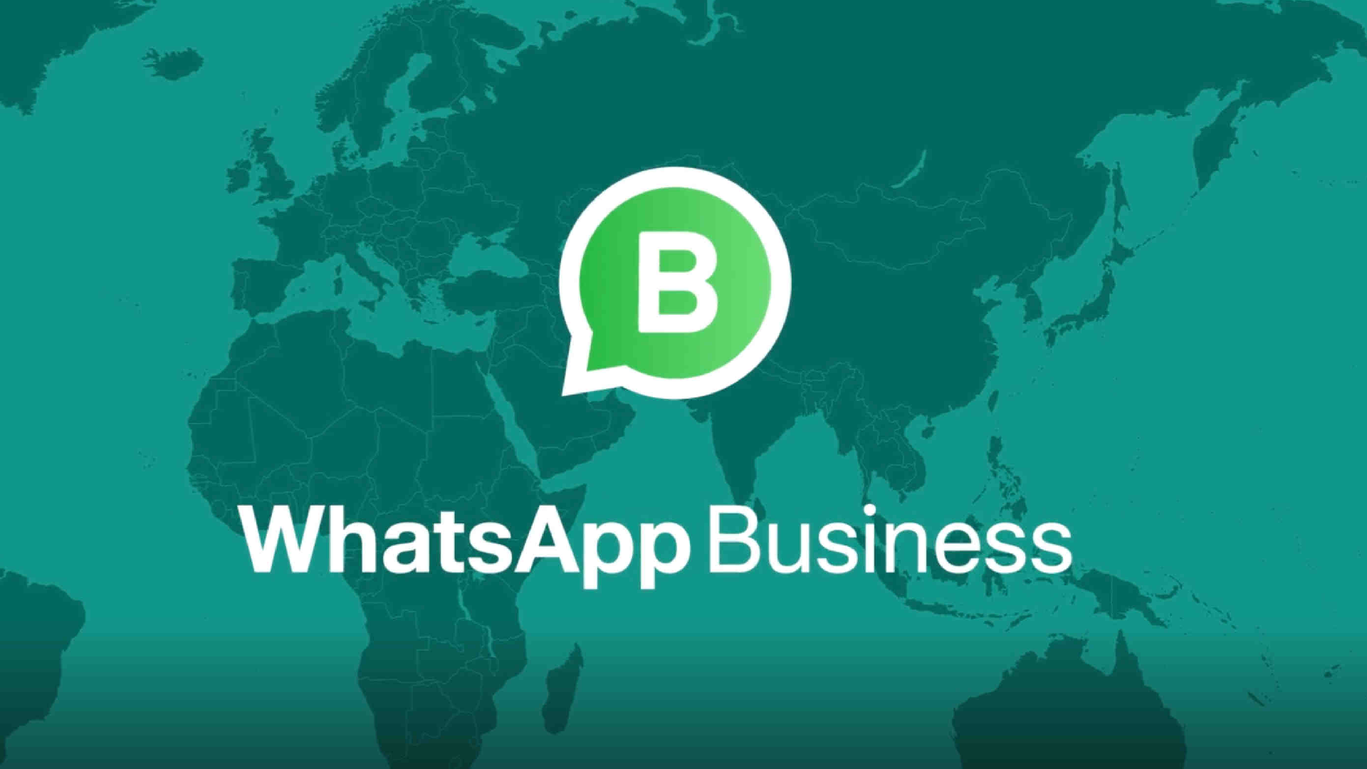

Slide 2
About
WhatsApp Business is a free to download app that was built with the small business owner in mind. Create a catalog to showcase your products and services. Connect with your customers easily by using tools to automate, sort and quickly respond to messages.
Highlights
WhatsApp has a large active user base across the world.
It's simple and easy to use features allows users to adopt very quickly App has a high rating and a high referral rate
Problem Stmt
WhatsApp is planning to get into “Dukaan-Tech” by leveraging its existing platform. The idea is to empower small business owners by helping them create online shops, order placement, customer support, etc.
Objective
Goal is to identify the market potential for WhatsApp Business in India and build a case for the same

Slide 3
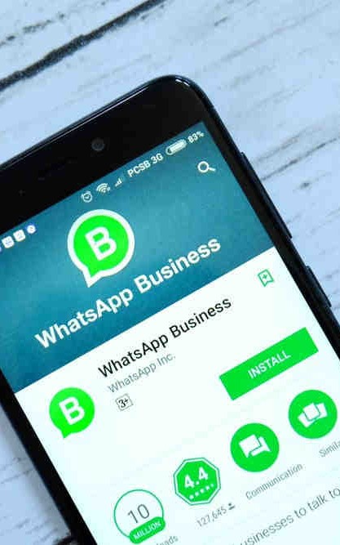
Why Dukaan Tech
WhatsApp has penetrated a target group which was unreachable by e-commerce giants in India. We see that in this market, small businesses are already using WhatsApp as a medium to share catalogues with their customers.
Some form of WhatsApp Business exists in this space. Further, there is a growing familiarity in users in this space about buying through WhatsApp. Long tail products are more likely to be sold as a resultant of a WhatsApp conversation.
Now, we shall define our target group and identify the market potential.

Slide 4


User Personas
32yr old Ashwini living in Trichy, is a home-maker. She lives with her husband, 2 children, her in-laws and their children. Her husband is a professor in a nearby school. Her brother-in-law owns a grocery shop next door. The family runs on a budget. They save up during the year for Diwali shopping and expenses. She and her sister-in-law, just like the most in the neighbourhood are regulars at Pandiyan's
42yr old Pandiyan living in Trichy owns a Saree and Jewellery Shop. He is lively person and knows almost everyone around his shop by name. He remembers his customers vividly and understands their interests. His customers know him for a great service and is very popular among them. Festive season is the busiest and his shop fills up with all his regular customers on their annual shopping agenda

Slide 5
Market Potential
Target Group
Seller
Small to Medium business in India
Residing in tier-2 tier-3 cities May own a local store
Access to smartphone and internet
Familiar with WhatsApp
Potential = No. of families in middle income group in Tier-1, Tier-2 Tier-3 cities in India, having access to smartphone and internet * Annual spending potential on festive shopping.
No. of families in middle income group in Tier-2 Tier-3 cities in India, having access to smartphone and internet = (No. of people having access to smartphone and internet in India) / Average household strength in India) * % Middle income group
Buyer
Middle income group in India Families residing in tier-2 tier-3 cities
Access to smartphone and internet
On WhatsApp
= (10,00,00,000 / 4) * 50%
= 1,25,00,000 Families
Annual spending potential on festive shopping = Average annual income of a household in middle income group * % spent on shopping
= 5 Lakh per annum * 5%
= Rs 25000 per annum
Total Potential = $4B * 1% convenience fee = $40M

Slide 6
Hypothesis
We believe Pandiyan will be able to increase his revenue by selling on WhatsApp
Pandiyan
Pandiyan is familiar with WhatsApp or can be easily trained. Pandiyan sees value in selling through digital means.
He has access to inventory and already has a few customers. He sells long-tail products.
He knows how to engage with customers, understand their need and deliver relevant
products.
He ensures the delivery of products.
Ashwini
She trusts Pandiyan with her purchases.
Buying from a catalogue shared on WhatsApp is not uncommon for her
Assumptions

Slide 7
Risk
Which assumptions
Pandiyan is familiar with WhatsApp or can be easily trained.
He has access to inventory and already has a few customers.
Buying from a catalogue shared on WhatsApp is not uncommon for Ashwini
Pandiyan sees value in selling through digital means.
to validate using the
He knows how to engage with customers, understand their
MVP?
Let's classify the assumptions we have now from Low-High Difficulty and Low-High Risk of validating.
We shall pick the high-risk low-difficulty first to validate our idea.
He ensures the delivery of products.
need and deliver relevant products.
Ashwini trusts Pandiyan with her purchases.
He sells long-tail products.
Difficulty

Slide 8


Minimum Criteria
Scope
We shall limit our scope to Activation, Adoption and Task Success with the MVP
Acquisition, Engagement, Happiness and Retention will be out of the scope of this study.
for Success
Activation - No of users creating, business profiles. No of catalogue shared.
Adoption - No of sales through WhatsApp
Task Success - Total value of sales through WhatsApp

Slide 9
What goes in the MVP?
Who is Pandiyan? - Profile
Maintain his inventory - Catalogue with picture of the item, description and price Converse with a customer - Identify a contact from list or go to a group. Strike a conversation over chat.
Identify items of interest for a customer. - Browse through the catalogue and find items that match customer's interest.
Share the right item with the customer - Send the catalogue to a customer or group Tag those thread which are more likely to be converted - Indicate items selected by the customer.
Track his orders - A place to look at the status of all his orders

Slide 10
Download WhatsApp Business
Registers
Phone number
Creates a Profile
Creates a Catalogue
Journey Map of
MVP
Finds a
contact/group on his list
Task Success
Task Unsuccessful
Strikes a conversation with a customer
See more
YES
NO
Browse Catalogue, Share relevant items
YES
Search more?
NO
YES
Customer Likes any?
Add to wishlist?
NO
Place order
Want to buy?
Can be done in v2
Can be done in v2

Slide 11
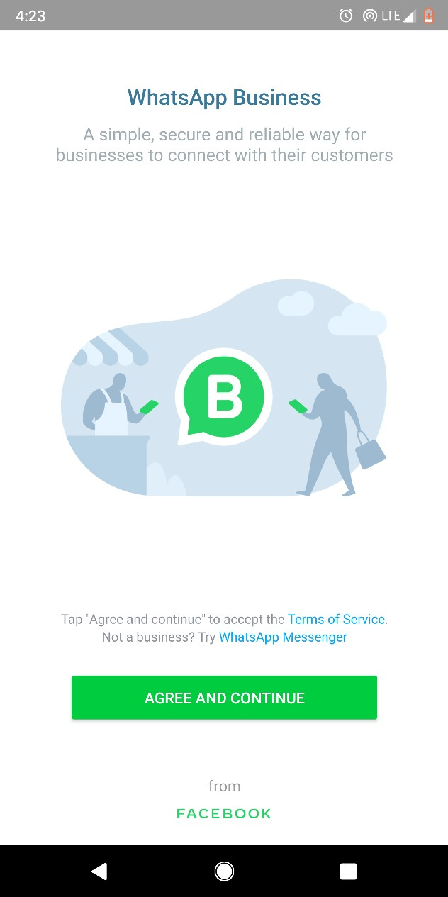
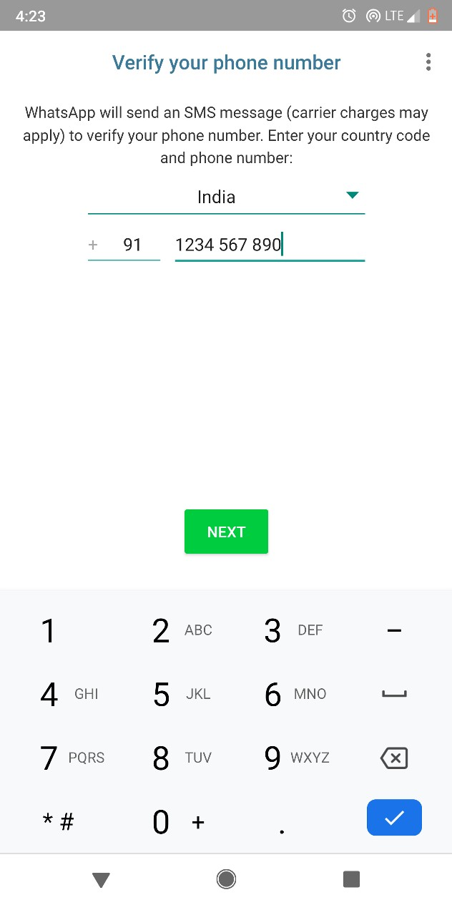
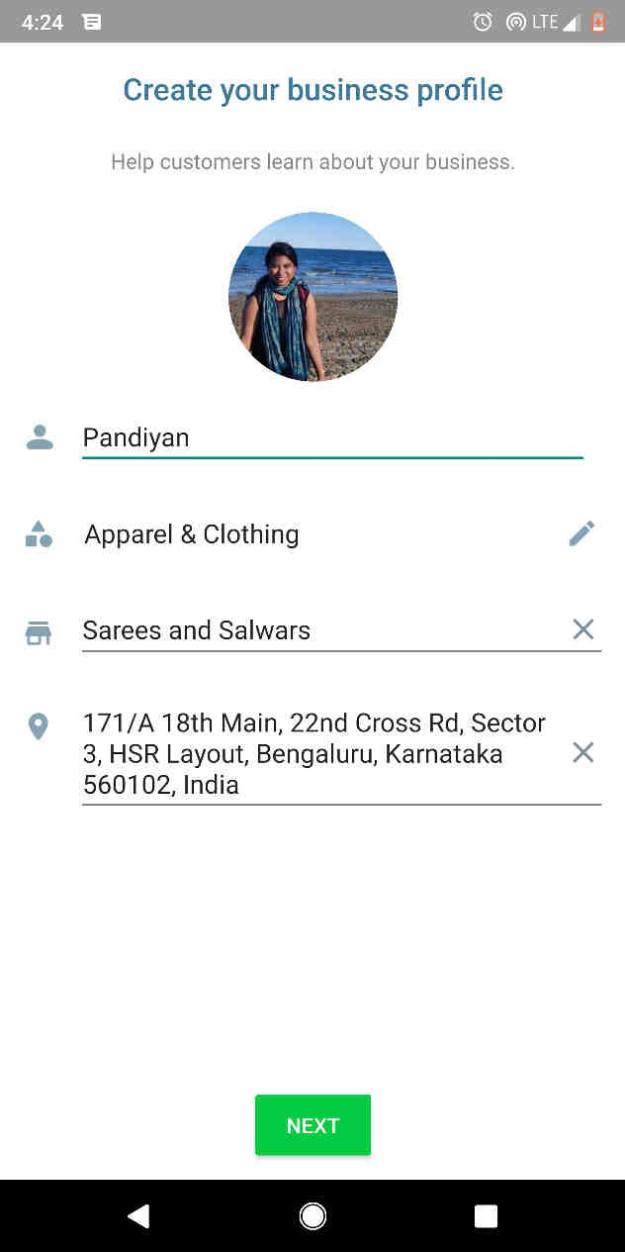

Register & Create Profile
171, 18th main Road. MG Nagar, Trichy

Slide 12
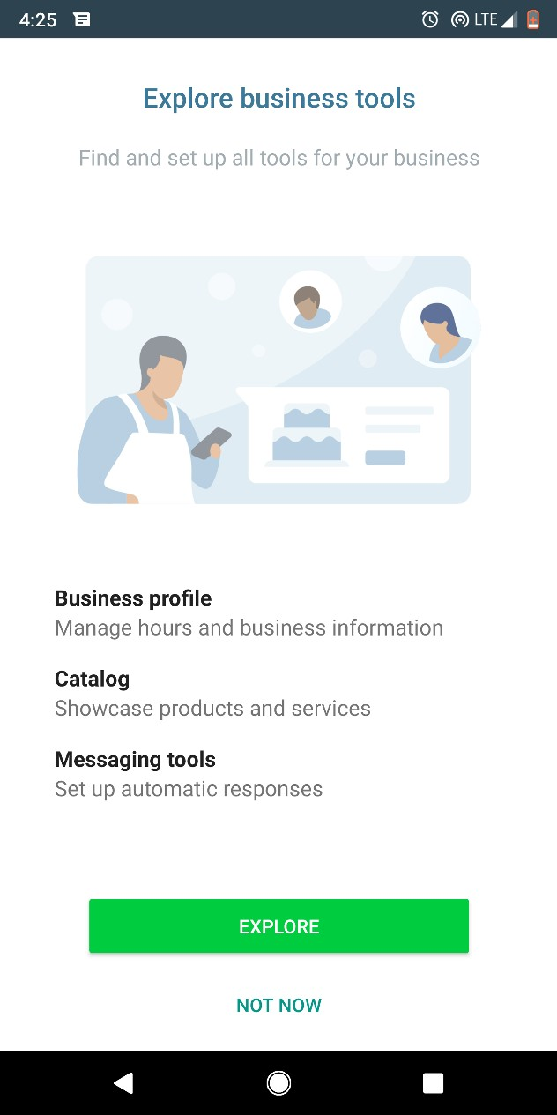
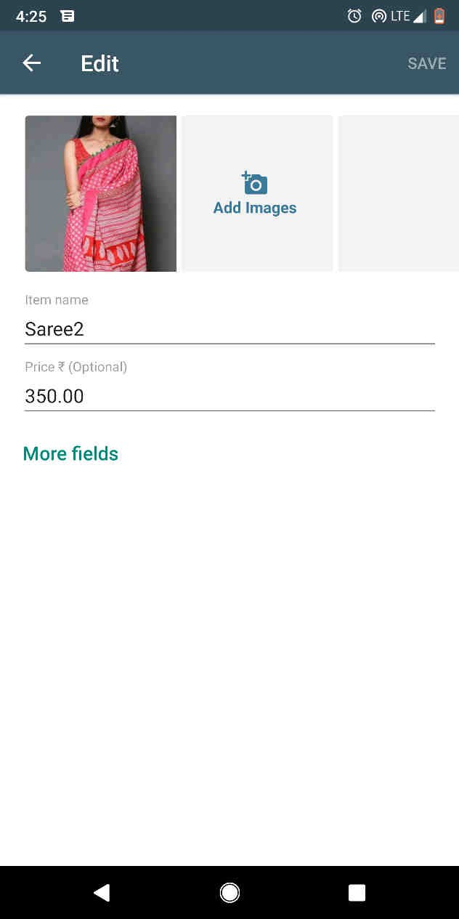
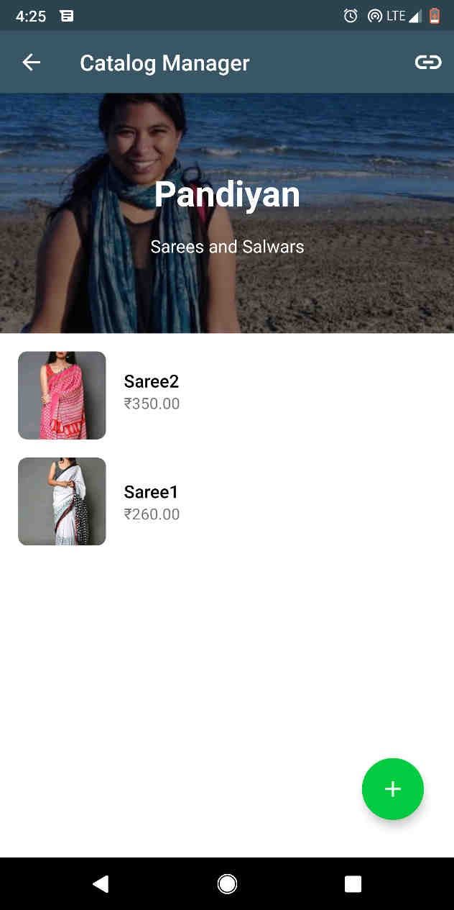

Create a Catalogue
Pandiyan
Sarees and Salwars

Slide 13
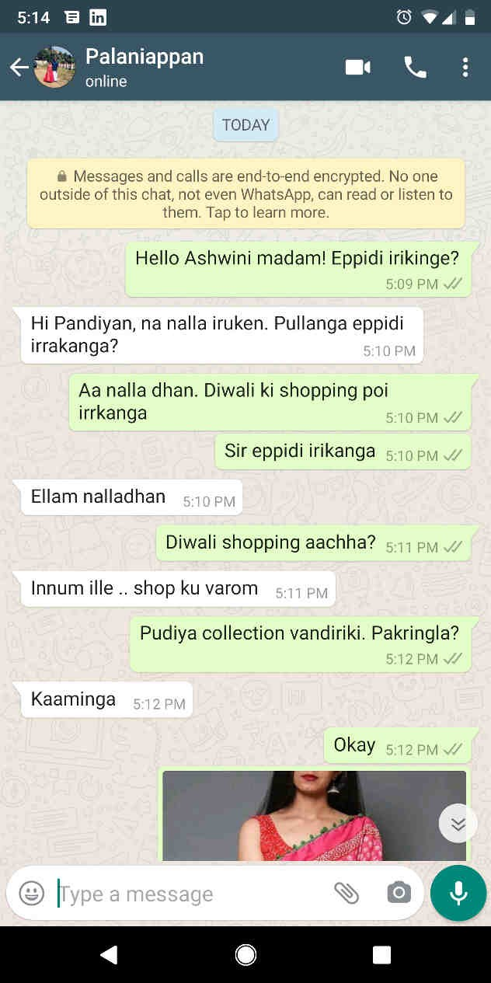
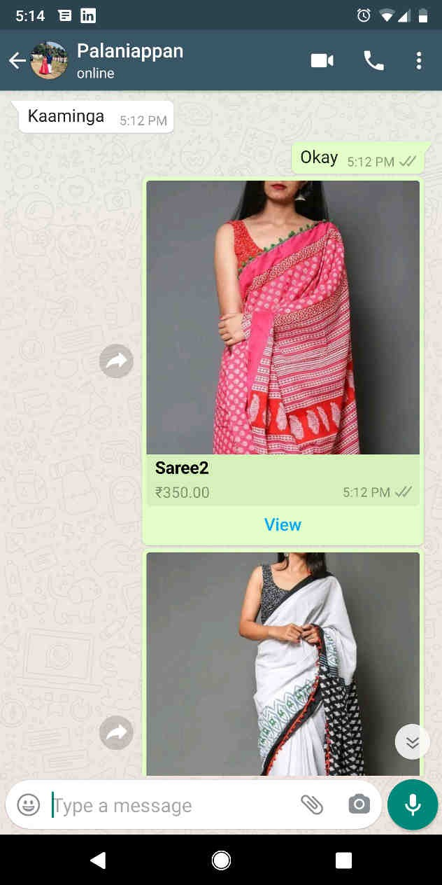
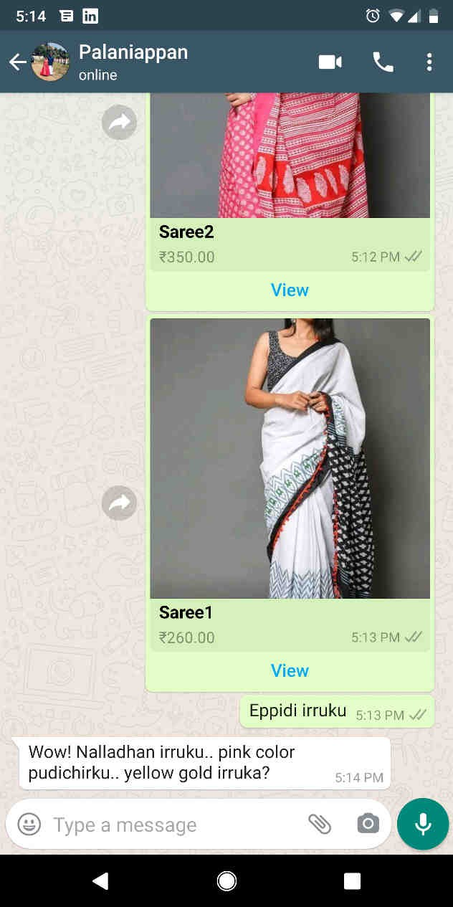





Chat with Customer & Share items
Ashwini
Ashwini

Slide 14
Success Criteria
Goals
Signals
Metrics
Happiness
User Satisfaction
Feedback. Reviews
App rating. NPS
Engagement
User Content Delivery
No of active users. No of business profiles created
DAU/MAU, Average Session Time
Adoption
User Onboarding
No of sales per month
Avg Time to value
Retention
Loyalty
Uninstall rate
Lifetime customer value
Task Success
User Goals Completion
Total value of sales
Average sales per account

Slide 15
THANK YOU
Subhadip Samanta
IIFT Delhi

